Slide 1

Delegation360
Owner: Allie Sonevytsky
Product Owner
Meeting Minutes:
May 2026
MVP Requirements Workshop MASTER MEETING MINUTES x 2026.docx
©2026 CVS Health and/or one of its affiliates. Confidential and proprietary.

Slide 2
D360 Foundational Architecture | Draft Epic Assumptions
D360 functionality will live inside, thus be accessed via, the CVS Appian portal
Example: WIREFRAMES for P360
Critical systems that will feed data into D360:
Archer
EPDB
SCM
CTR
Procurement
IABOR*
Archer will update D360 with all associated data points DAILY

Slide 3
D360 MVP Functionality | Draft Epic Assumptions
There will only be TWO delegation types for D360 MVP: (1) Clinical (2) Claims
Clinical has UM (Utilization) & PHM (Provider Health)
Not Credentialing or Customer Service
All associated DSOT data will be read-only
No D360 data will be editable or added new from D360 to backend systems
There will only be ONE user type for D360
No variation in what D360 users can/cannot view by user type
>> 1 Super User Type = Read/Write fields (fields TBD)
>> 1 Standard User Type = Read-Only fields

Slide 4
D360 MVP Functionality | Draft Feature Assumptions
MVP Product Vision:
“D360 is a cloud application that captures and reports provider and vendor delegate attributes within the Clinical and Claims processes of Value Based Care Delegations”
Key D360 MVP Functionality:
D360 has key delegate attributes efficiently accessible and visible
D360 has robust filtering functions for critical and variant reporting use cases
D360 has 2 user types to access data: Read-Only vs. Edit (data quality & maintenance)
D360 has process stage progress displayed and updated daily <– descoped for MVP; needs more discovery research for I2

Slide 5
D360 MVP > Clinical | Super User – Edit Fields inside D360
Field Name | Single Source System | Aggregated Systems & Fields | NEW Fields | Field Types
Accumulators
Audited Entity | Archer
Audited Entity Status | Archer
Contract Effective Date | SCM/CTR/Procurement
Contract Renewal Date | SCM/CTR/Procurement
Contract Term Date | SCM/CTR/Procurement
Contracted Entity Address 1 | Archer
Contracted Entity Address 2 | Archer
Contracted Entity City | Archer
Contracted Entity Name | SCM
Contracted Entity State | Archer
Contracted Entity Zip | Archer
Corrective Action Plan | Archer
Decision Auth Communication | NEW – D360 BASED |  | Free Text > confirm character count with Appian
Delegate Entity Type | Archer
Delegated Entity Contacts | Archer, CA IPA Quickbase
Delegated Services | SCM/CTR/Procurement
Delegation Type | Archer
Encounter Submission
Engagement Mgr | IABOR BDA Tables/CTR/ Archer
Line of Business | Archer
Model by delegation type | CTR
MSO | Archer
Network Contractor | Archer
Oversight Audit Timeline | Archer
Product | Archer
Service Area | SCM/CTR/Procurement
State | SCM/CTR/Procurement
TIN | EPDB
Tracking ID | Archer

Slide 6
D360 MVP > Clinical | Key Delegate Attributes DRAFT Notes for Discussion Only
Accumulators | ??
Audited Entity | Archer
Audited Entity Status | Archer
Contract Effective Date | SCM/CTR/Procurement
Contract Renewal Date | SCM/CTR/Procurement
Contract Term Date | SCM/CTR/Procurement
Contracted Entity Address 1 | Archer
Contracted Entity Address 2 | Archer
Contracted Entity City | Archer
Contracted Entity Name | SCM (Conga = Medicaid;
Contracted Entity State | Archer
Contracted Entity Zip | Archer
Corrective Action Plan | Archer
Decision Auth Communication | ??
Delegate Entity Type | Archer
Delegated Entity Contacts | Archer, CA IPA Quickbase
Delegated Services | SCM/CTR/Procurement
Delegation Type | Archer
Encounter Submission | ??
Engagement Mgr | IABOR BDA Tables/CTR/ Archer
Line of Business | Archer
Model by delegation type | CTR
MSO | ??
Network Contractor | Archer
Oversight Audit Timeline | Archer
Product | Archer
Service Area | SCM/CTR/Procurement
State | SCM/CTR/Procurement
TIN | EPDB
Tracking ID | Archer
Archer ID = Tracking ID
Entity Name = Contracted Entity Name
Audited Entity
State
Line of Business
Delegation Type
Delegation Agreement-Y/N
Financial Risk Type-Medical = VBC Contract Risk Type?
(Aetna Quality Oversight Audit?-Y/N) = Oversight Audit Timeline*? Not Y/N but Yearly/Last Completed/Next Due
Corrective Action Plan
Operations KPIs
Key Network Contact Info = Network Contractor
MSO Name = MSO
Communication of Decision = Decision Auth Communication
= California IPA fields (AZ)
Sources:
Data fields, system sources, and example field values: Source of Truth_attributes and systems_MVP022626.xlsx
Data fields, example field values, and Clinical and Claims mock examples of current data tracking: Source of Truth Required Fields DRAFT.xlsx

Slide 7
D360 MVP Requirements | Key Delegate Attributes Epic
Discussions/Agenda:
Confirm and refine data field labels > Data Fields_MASTER tab vs. Clinical Example tab
Clarify AZ rows from Clinical Example tab
Missing data field SOURCE updates for Data Fields_MASTER tab
Appian Field Type Configuration Discussion
-------------------------------------
NEW FIND: GRITT QuickBase |
Several fields grabbing Delegation data into Quickbase – worth investigating use case and maintenance practices
Business Owner: Michelle Swart Smith <mssmith@aetna.com>

Slide 8
Delegation Source of Truth
Owner: Clarridge, Kimberly
Date: 1/23/26
Summary:
Value Statement: Creating a single Source of Truth (SoT) for all delegate partners—including providers and vendors by type, product, membership, services, status, service area, and effective/term dates—provides teams with a unified, accurate, and consistent dataset. This reduces errors and duplication, improves decision‑making, enhances collaboration, and accelerates timelines, ultimately improving productivity and strengthening competitive advantage. Problem Statement: Delegation data is currently stored across multiple, non‑integrated systems, making it difficult to produce a complete and reliable list of delegate partners. This fragmentation creates data inconsistencies, compliance risks, miscommunication, and manual rework, slowing decision‑making and eroding trust in data quality. These issues are already evident in the difficulty identifying all UM delegates needed for CMS Final Rule updates, including criteria, letter translation, and interoperability. Solution: Implement a centralized Delegation Source of Truth, consolidating all partner attributes into one governed, accessible, and integrated dataset. This solution will eliminate data silos, improve accuracy, streamline regulatory and operational work, and enable all teams to operate from a single, trusted view of delegation data.
Risks/Issues/Watch Items
Description | Action/Resolutions | Status/Owner
Accomplishments/Decisions
Completed Items: Deep dive session to document high level requirements and business needs. In Progress: Kim Wuestenberg is documenting the current and Future state diagrams for this process. Next Steps Schedule alignment session with Kim and Alan to review outstanding questions from Kim. Identify the current process steps that need deeper data flow mapping. Schedule recorded sessions with team to document the current data flow. Determine how this initiative can be split to ensure progress can continue forward and teams onboarded while the current and future state diagrams are being complete. Get an Enterprise Architect assigned. Begin aligning on a requirements repository while architectural analysis is being done Begin documenting and creating the product backlog while the prework is being done.
Milestones
Key Milestones | End Date/Status
Discovery & Alignment (Identify business problem, success metrics, stakeholders, in/out of scope items, assumptions & constraints) | 2/6/2026
Requirements Definition (Functional & non-functional requirements, primary use cases, dependencies & integrations) | 2/27/2026
Solution Architecture & Design (Current & Future State Defined (business) Solution diagram (DDAT), Data flows & integration mapping) | TBD
Feature Definition (Finalize feature list, acceptance criteria, MVP defined, success metrics & feature value statements)
Team Onboarding & Commitments (DDAT teams Identified, stakeholder list created, estimates collected, capacity aligned)
Estimation & Delivery Commitments (Estimates collected, capacity validated, risks & assumptions documented, delivery timeline received)
Readiness & Go / No Go Approval
Status Key: | Not Started | Completed | On Track | At Risk | Off Track

Slide 9
Delegation 360 MVP
IABoR
OBoR
Feed to GCP BQ
Sourcing
CVS Health Appian Org
P360 App
PDRE App
Cloud Provider
Database
Del Compliance
Maintenance
API
Annex
Data
Access
Annex
D360 App
APIc
Java
Delegation
Compliance
Delegation
Compliance
Management
Maintenance
API
Data
Access
APIc
Java
Delegation
Delegation
Maintenance
Inquiry
API
Data
Access
Staff
APIc
Java
SCM
EPDB
AWS
PostgreSQL
Delegation
Inquiry
Mainframe
DB2
Mainframe
DB2
API
Web/Java
APIc
Archer
Archer
Data
Daily Delegation
Update & Load

Slide 10
Delegation 360 MVP Conceptual Data Model
Delegation
Type
Code (Clinical, Claims)
Description
(I)
Delegate
Delegation
(I)
Id
Name
etc.
(I)
Id
FK Del Type Code
Effective Date
Expiration Date
etc.
(I)
Compliance
Topic
Delegation
Compliance
Topic
(I)
Id
Name
Description
Due Date
Status
Completion Date
Initial Reply Due Date
Requestor
Requestor email
(I)
FK Topic Id
FK Delegation Id
FK Delegation Eff
Status
Completion Date
Description
etc.
(I)
(I)
Compliance
Event
Compliance
Attachment
(I)
FK Topic Id
FK Delegation Id
FK Delegation Eff
Date
Email Address
Type
Description
etc.
(I)
FK Topic Id
FK Delegation Id
FK Delegation Eff
Date
File
(I)
(I)
(I)
(I)
(I)
(I)

Slide 11
D360 MVP > Clinical | Super User – Edit Fields inside D360 DRAFT Notes for Discussion Only
Field Name | Source System | Field Type | Field Values
Tracking ID | Archer | Free Text | [Numeric]
Contracted Entity Name | SCM | Free Text | [Alphanumeric]
Audited Entity | Archer | Free Text | [Alphanumeric]
State | SCM/CTR/Procurement | Dropdown (Single Select)
Line of Business | Archer | Dropdown (Multi Select)
Delegation Type | Archer | Checkbox (Multi Select)
Delegate Entity Type | Archer | ??
Oversight Audit Timeline | Archer | Dropdown (Single Select)
Corrective Action Plan | Archer | Checkbox (Multi Select)
Delegated Entity Contacts | Archer | Free Text | [Alphanumeric]
MSO | ??? | Free Text | [Alphanumeric]
NO LONGER APPLICABLE
Proposed Field Name | Field Type | View Access Level
Decision Auth Communication | Free Text | All
Sources:
Data fields, system sources, and example field values: Source of Truth_attributes and systems_MVP022626.xlsx
Data fields, example field values, and Clinical and Claims mock examples of current data tracking: Source of Truth Required Fields DRAFT.xlsx

Slide 12
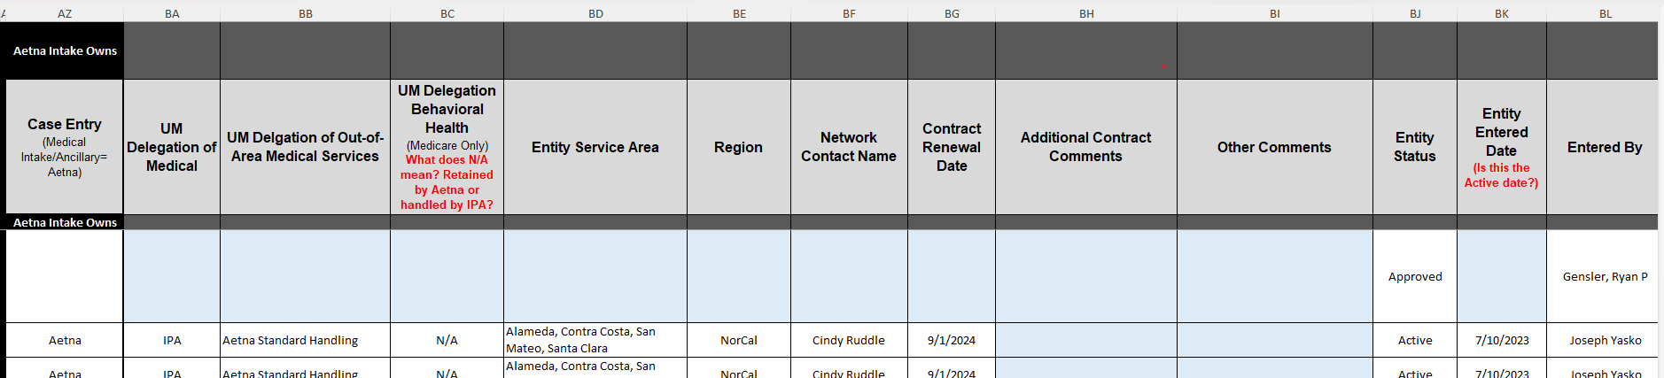
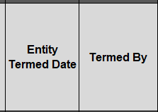
D360 MVP > Clinical | Key Delegate Attributes DRAFT Notes for Discussion Only
Accumulators | ??
Audited Entity | Archer
Audited Entity Status | Archer
Contract Effective Date | SCM/CTR/Procurement
Contract Renewal Date | SCM/CTR/Procurement
Contract Term Date | SCM/CTR/Procurement
Contracted Entity Address 1 | Archer
Contracted Entity Address 2 | Archer
Contracted Entity City | Archer
Contracted Entity Name | SCM (Conga = Medicaid;
Contracted Entity State | Archer
Contracted Entity Zip | Archer
Corrective Action Plan | Archer
Decision Auth Communication | ??
Delegate Entity Type | Archer
Delegated Entity Contacts | Archer, CA IPA Quickbase
Delegated Services | SCM/CTR/Procurement
Delegation Type | Archer
Encounter Submission | ??
Engagement Mgr | IABOR BDA Tables/CTR/ Archer
Line of Business | Archer
Model by delegation type | CTR
MSO | ??
Network Contractor | Archer
Oversight Audit Timeline | Archer
Product | Archer
Service Area | SCM/CTR/Procurement
State | SCM/CTR/Procurement
TIN | EPDB
Tracking ID | Archer
Sources:
Data fields, system sources, and example field values: Source of Truth_attributes and systems_MVP022626.xlsx
Data fields, example field values, and Clinical and Claims mock examples of current data tracking: Source of Truth Required Fields DRAFT.xlsx

Slide 13
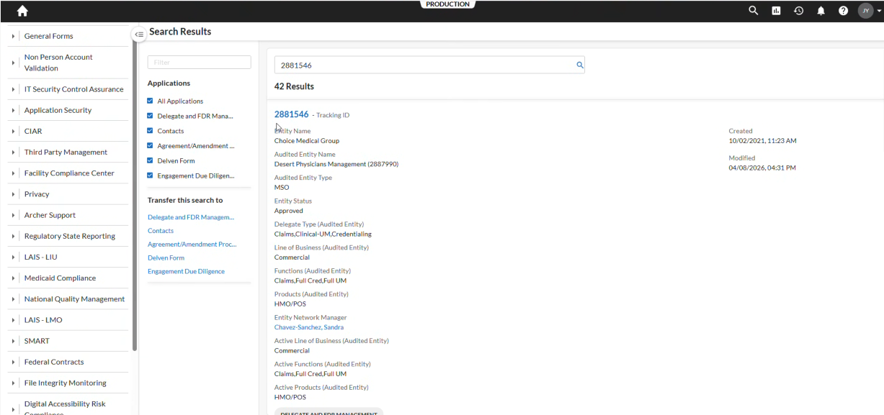
Archer Demo Screenshots (5/11/26)

Slide 14
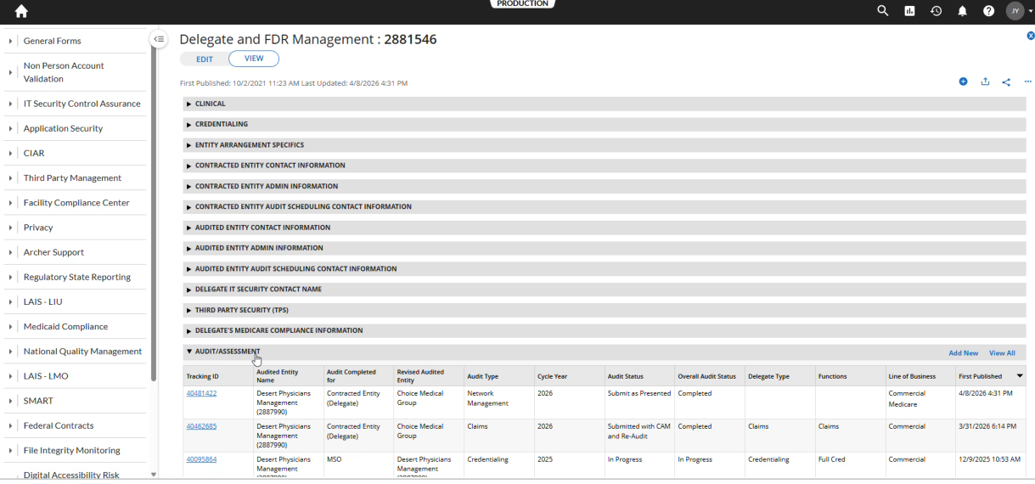
Archer Demo Screenshots (5/11/26)

Slide 15
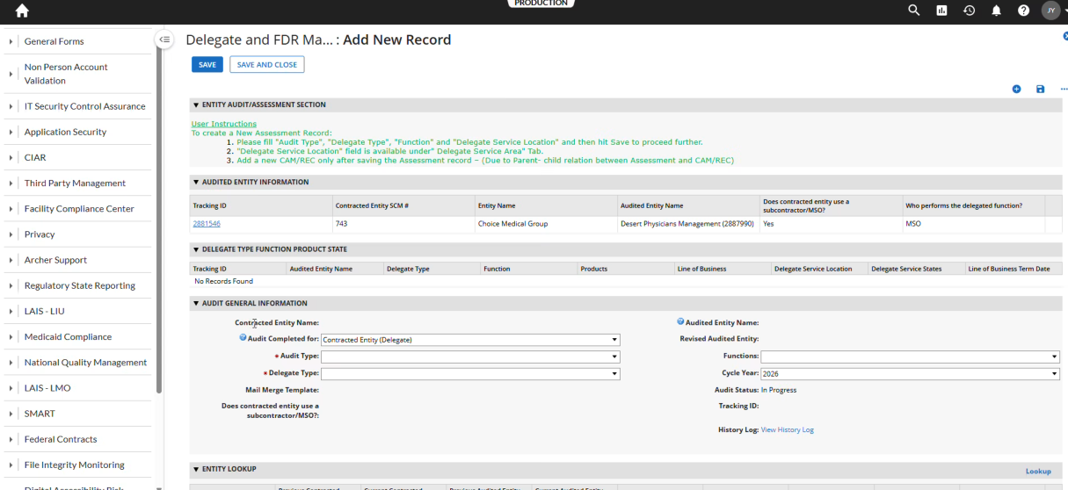
Archer Demo Screenshots (5/11/26)

Slide 16
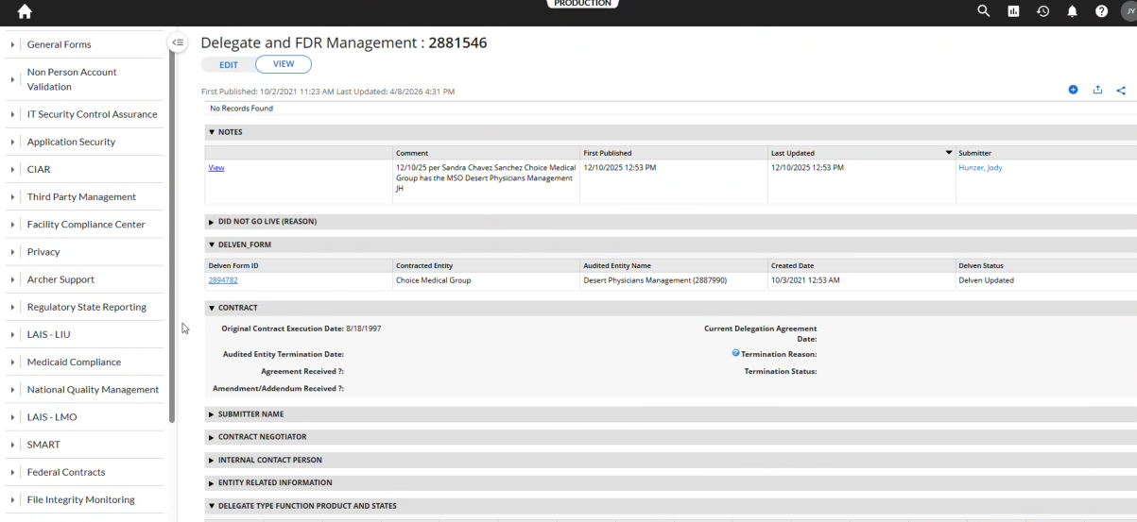
Archer Demo Screenshots (5/11/26)

Slide 17
Archer Demo Screenshots (5/12/26)

Slide 18
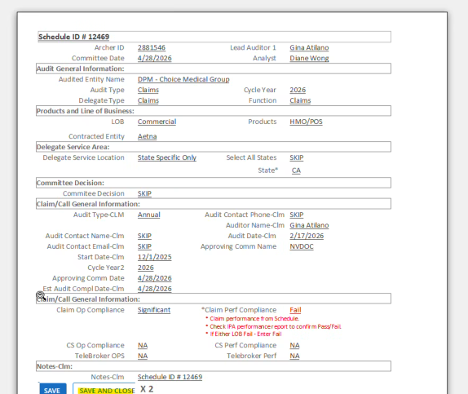
Archer Demo Screenshots (5/11/26)
DelVen form?
Audit form?

Slide 19
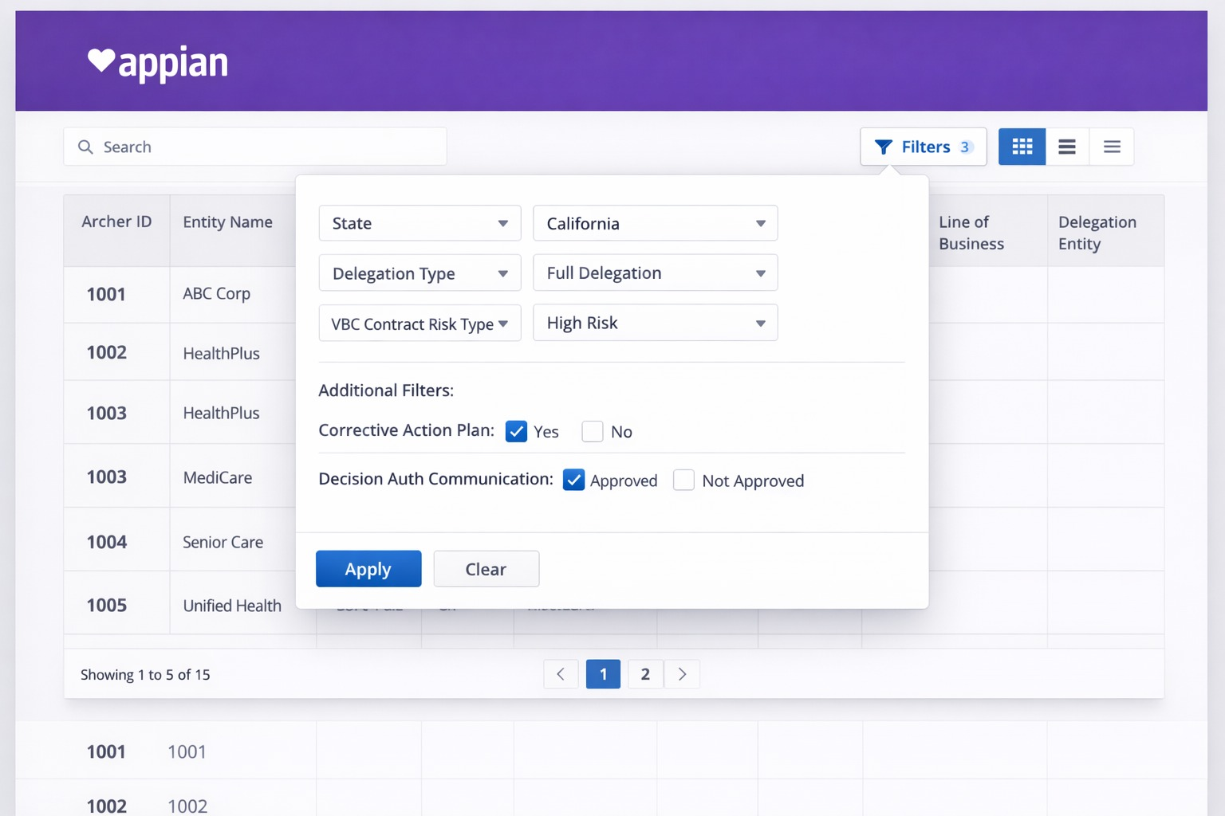
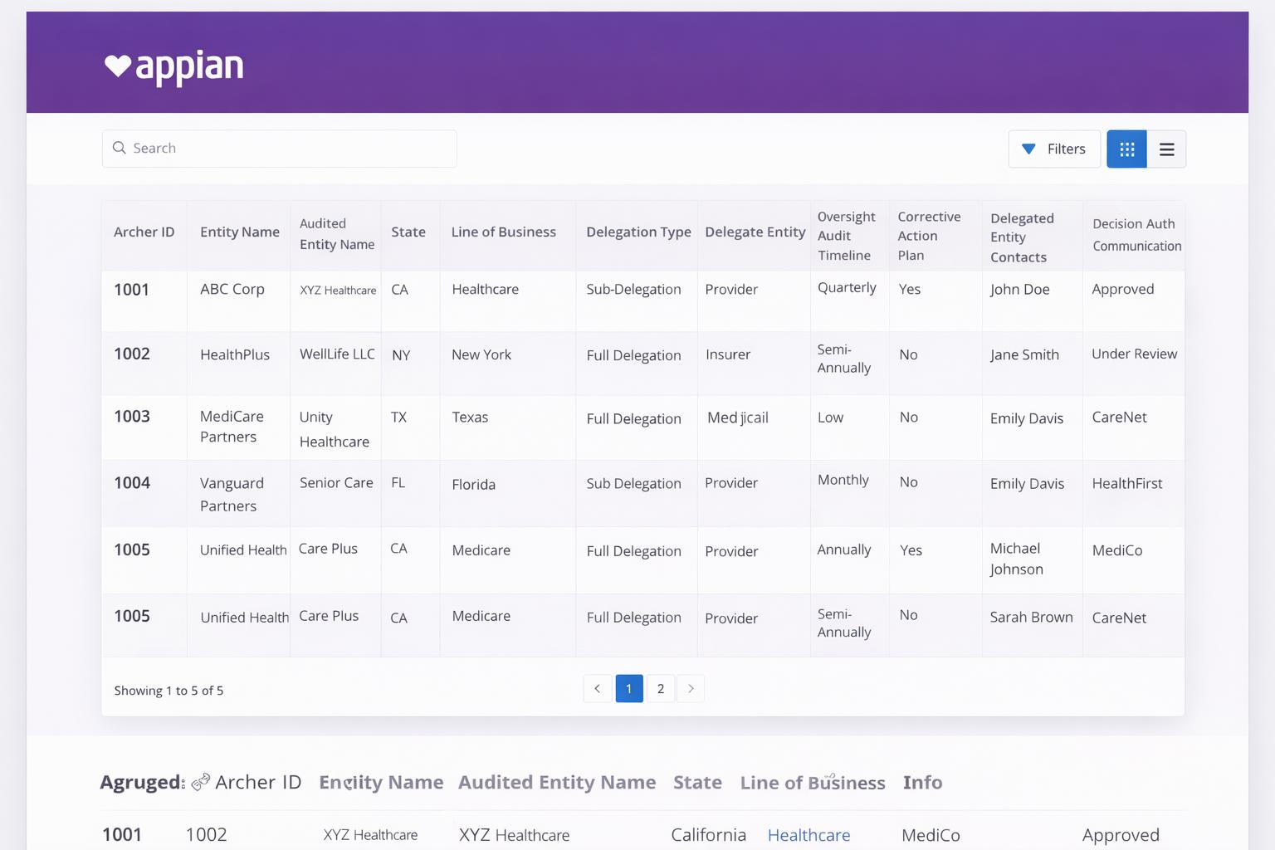
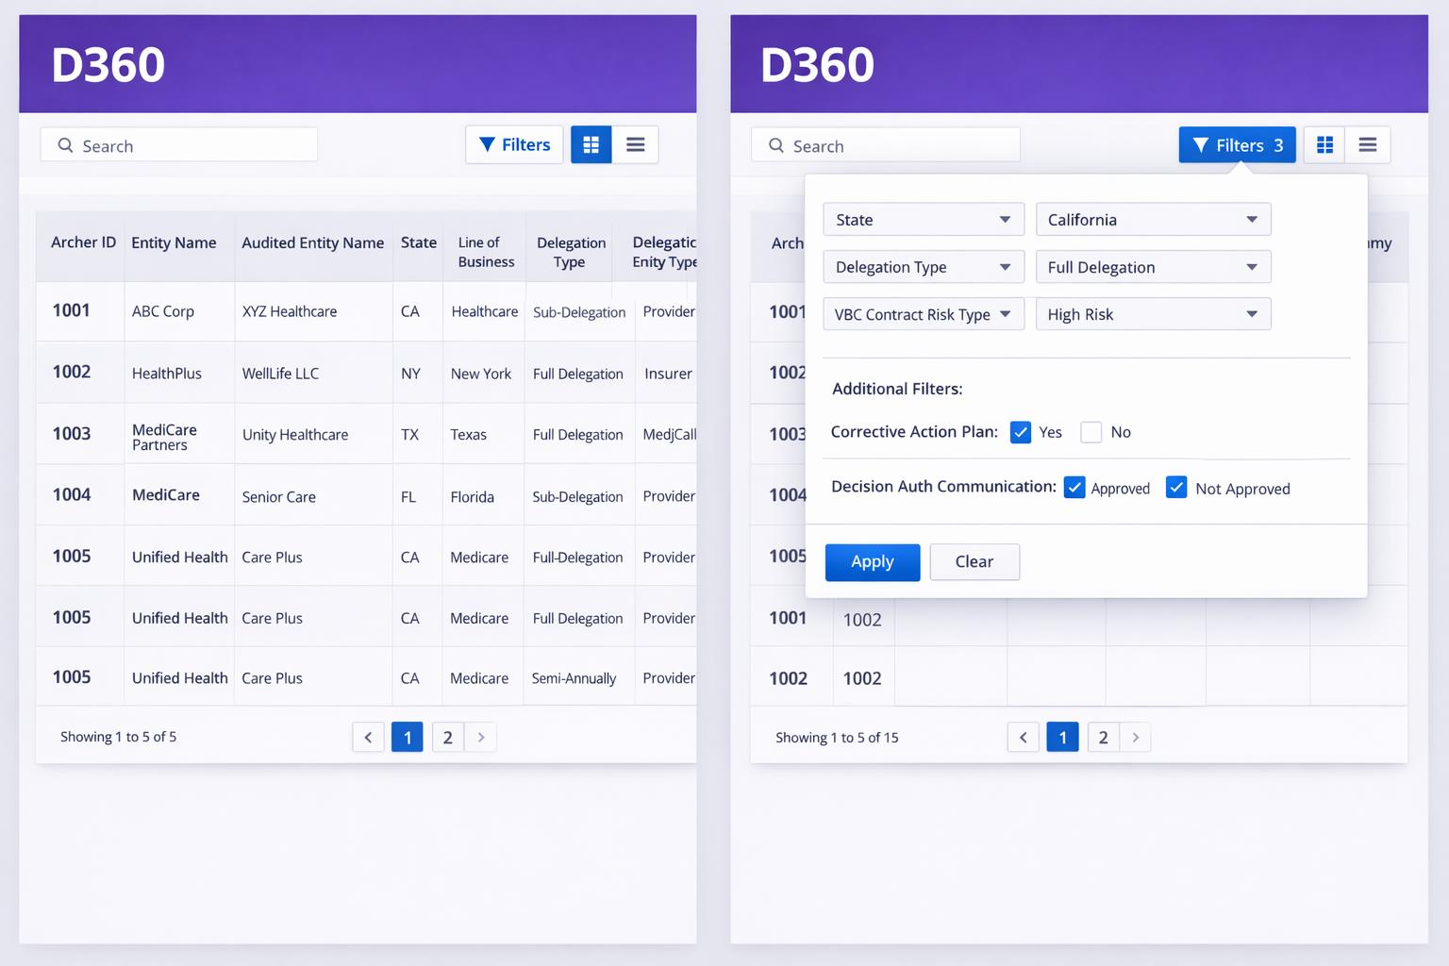
D360 MVP > Clinical | Wireframe Mockups DRAFT for Discussion Only

Slide 20
Agenda 1
Agenda item one
Speaker and topic
Agenda item two
Speaker and topic
Agenda item three
Speaker and topic

Slide 21
Divider slide with white heart pattern

Slide 22
Divider slide with dark heart pattern

Slide 23
Title for one-column layout
The body text is 13-point CVS Health Sans in Text Gray.
This single column text box width is two-thirds of the page width. Do not extend this text box. You can use a two-column layout if you need to use the full width of the page.
First-level bullet
First-level bullet
Second-level bullet
Footnote/Source information.
Copy, paste and edit the text in Footnote/Source placeholder as needed. Do not resize or reposition the text box.
Minimum size for footnotes: 10-point ― Commercial/member facing
11-point ― Medicare/member facing
Footnote/Source placeholder: Enter footnote/source copy in this live text box. Text will wrap up from bottom of text box. Do not resize or reposition this text box.

Slide 24
Title for one-column layout with header
Header is 18-point CVS Health Sans Bold in Text Gray
The body text is 13-point CVS Health Sans in Text Gray.
This single column text box width is two-thirds of the page width. Do not extend this text box. You can use a two-column layout if you need to use the full width of the page.
First-level bullet
First-level bullet
Second-level bullet
Footnote/Source information.
Copy, paste and edit the text in Footnote/Source placeholder as needed. Do not resize or reposition the text box.
Minimum size for footnotes: 10-point ― Commercial/member facing
11-point ― Medicare/member facing
Footnote/Source placeholder: Enter footnote/source copy in this live text box. Text will wrap up from bottom of text box. Do not resize or reposition this text box.

Slide 25
Title for two-column layout
Header is 18-point CVS Health Sans Bold in Text Gray
The body text is 13-point CVS Health Sans in Text Gray.
First-level bullet
First-level bullet
Second-level bullet
Header is 18-point CVS Health Sans Bold in Text Gray
The body text is 13-point CVS Health Sans in Text Gray.
First-level bullet
First-level bullet
Second-level bullet

Slide 26
Title for three-column layout
Header is 18-point CVS Health Sans Bold in Text Gray
The body text is 13-point CVS Health Sans in Text Gray.
First-level bullet
First-level bullet
Second-level bullet
Header is 18-point CVS Health Sans Bold in Text Gray
The body text is 13-point CVS Health Sans in Text Gray.
First-level bullet
First-level bullet
Second-level bullet
Header is 18-point CVS Health Sans Bold in Text Gray
The body text is 13-point CVS Health Sans in Text Gray.
First-level bullet
First-level bullet
Second-level bullet

Slide 27
Title for four-column layout
Header is 18-point CVS Health Sans Bold in Text Gray
The body text is 13-point CVS Health Sans in Text Gray.
First-level bullet
First-level bullet
Second-level bullet
Header is 18-point CVS Health Sans Bold in Text Gray
The body text is 13-point CVS Health Sans in Text Gray.
First-level bullet
First-level bullet
Second-level bullet
Header is 18-point CVS Health Sans Bold in Text Gray
The body text is 13-point CVS Health Sans in Text Gray.
First-level bullet
First-level bullet
Second-level bullet
Header is 18-point CVS Health Sans Bold in Text Gray
The body text is 13-point CVS Health Sans in Text Gray.
First-level bullet
First-level bullet
Second-level bullet

Slide 28
Title for five-column journey layout
Pictogram library is available on the Brand Center.
Accessibility guidance
Pictograms must have a short description in Alt Text.
place pictogram 1 here
place pictogram 2 here
place pictogram 3 here
place pictogram 4 here
place pictogram 5 here
Header 1
Descriptor text here in 13-point CVS Health Sans.
Header 2
Descriptor text here in 13-point CVS Health Sans.
Header 3
Descriptor text here in 13-point CVS Health Sans.
Header 4
Descriptor text here in 13-point CVS Health Sans.
Header 5
Descriptor text here in 13-point CVS Health Sans.

Slide 29

Title with image on right layout
More images are available on CVS Health Assets.
Please direct questions to
CVSDAMSupport@ CVSHealth.com
The body text is 13-point CVS Health Sans in Text Gray.
First-level bullet
First-level bullet
Second-level bullet

Slide 30

Title with image on left layout
More images are available on CVS Health Assets.
Please direct questions to
CVSDAMSupport@ CVSHealth.com
The body text is 13-point CVS Health Sans in Text Gray.
First-level bullet
First-level bullet
Second-level bullet
30
©2026 CVS Health and/or one of its affiliates. Confidential and proprietary.

Slide 31
Title for one panel comparison layout
Pictogram library is available on the Brand Center.
Accessibility guidance
Pictograms must have a short description in Alt Text.
place pictogram 1 here
place pictogram 2 here
Header 1
Title and body copy are centered. Descriptor text here.
Header 2
Title and body copy are centered. Descriptor text here.

Slide 32
Title for two panel comparison layout
Pictogram library is available on the Brand Center.
Accessibility guidance
Pictograms must have a short description in Alt Text.
place pictogram 1 here
place pictogram 2 here
Header 1
Title and body copy are centered. Descriptor text here.
Header 2
Title and body copy are centered. Descriptor text here.

Slide 33
Title for four-point process
Pictogram library is available on the Brand Center.
Accessibility guidance
Pictograms must have a short description in Alt Text.
Item 1 The body text is 13-point CVS Health Sans in Text Gray.
Item 2 The body text is 13-point CVS Health Sans in Text Gray.
Item 3 The body text is 13-point CVS Health Sans in Text Gray.
Item 4 The body text is 13-point CVS Health Sans in Text Gray.

Slide 34
Title for comparison layout
Pictogram library is available on the Brand Center.
Accessibility guidance
Pictograms must have a short description in Alt Text.
place pictogram 1 here
place pictogram 2 here
Header 1
Title and body text are centered. Descriptor text here.
Header 2
Title and body text are centered. Descriptor text here.

Slide 35
Title for two-column comparison layout
Header is 18-point CVS Health Sans Bold in Text Gray
Header is 18-point CVS Health Sans Bold in Text Gray
The body text is 13-point CVS Health Sans in Text Gray.
First-level bullet
First-level bullet
Second-level bullet
The body text is 13-point CVS Health Sans in Text Gray.
First-level bullet
First-level bullet
Second-level bullet

Slide 36
Title for three-column comparison layout
Header is 16-point CVS Health Sans Bold in Text Gray
Header is 16-point CVS Health Sans Bold in Text Gray
Header is 16-point CVS Health Sans Bold in Text Gray
The body text is 13-point CVS Health Sans in Text Gray.
First-level bullet
First-level bullet
Second-level bullet
The body text is 13-point CVS Health Sans in Text Gray.
First-level bullet
First-level bullet
Second-level bullet
The body text is 13-point CVS Health Sans in Text Gray.
First-level bullet
First-level bullet
Second-level bullet

Slide 37
Title with infographic on right
20%
40%
The body text is 13-point CVS Health Sans in Text Gray.
First-level bullet
First-level bullet
Second-level bullet
Descriptor text for the stat above
Descriptor text for statistic above
1%
Descriptor text that explains the statistic on the left
32%
100%
Descriptor text that explains the number above
Descriptor text for statistic above

Slide 38
Title with infographic on left
20%
40%
Descriptor text for the stat above
Descriptor text for statistic above
The body text is 13-point CVS Health Sans in Text Gray.
First-level bullet
First-level bullet
Second-level bullet
1%
Descriptor text that explains the statistic on the left
32%
100%
Descriptor text that explains the number above
Descriptor text for statistic above

Slide 39
Charts, graphs and tables

Slide 40
Chart guidelines
Important: Instructional page — please delete before use
Accessibility guidance
Detailed information should be included in the Alt Text. If this information is complex, the data/info can be presented in an embedded Excel spreadsheet or in the notes section.
For more information on charts see the accessibility guidelines document on the Brand Center.
Chart colors
The chart colors and sequence apply across all businesses. A two-point white line has been added when colors appear next to each other. This makes it easier to distinguish different colors.
A chart add-in tool automatically populates the correct colors and sequence into the charts.
To update previous charts created with the former colors see next page.
The following updated colors are in the correct order and appear in the second row of the custom color palette.
Color order
1
2
3
4
5
6
7
8
9
10
11
12
13
14
15
If you have a chart needing more than 15 colors, please email us at BrandCenter@CVSHealth.com for assistance.

Slide 41
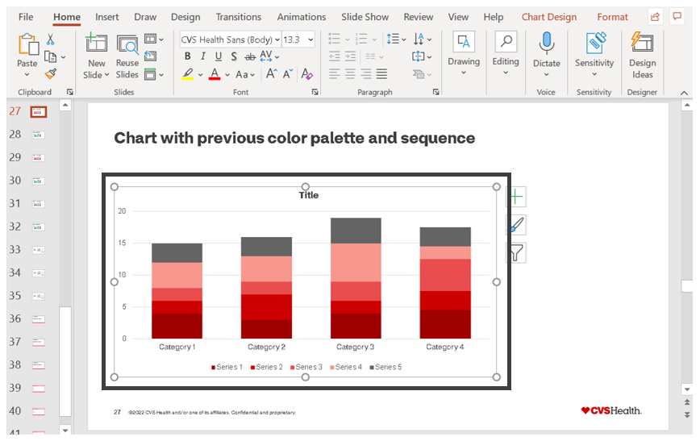
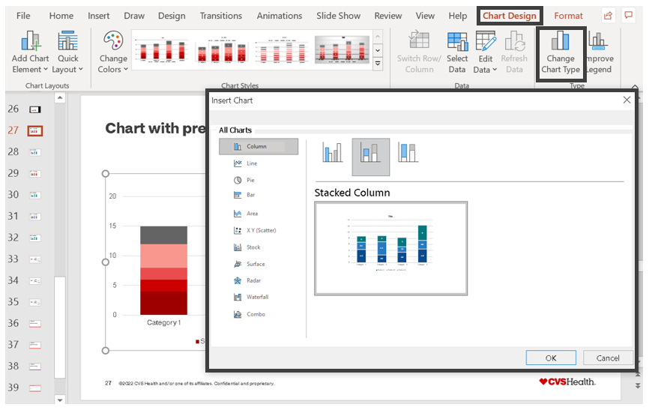
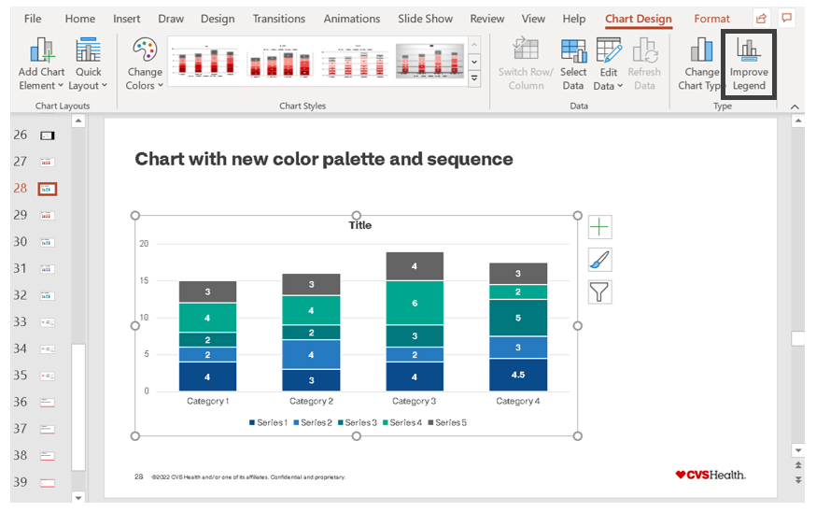
To update previous charts, use the new chart tool
Important: Instructional page — please delete before use
Click on the chart with the previous color palette.
In the “Chart Design” tab, click on “Change Chart Type.”
Via the “Insert Chart” menu that opens, browse to the matching chart and click “OK.”
The chart will automatically update to the correct colors in the right sequence as well as the updated design that helps with legibility and accessibility.
Once done, you can add chart elements as needed.
If data labels for charts are recommended, they will show up automatically.
There’s also a button in the tool for “Improve Legend” which will adjust the legend color squares to improve legibility.

Slide 42
Title for full page chart layout
To edit chart
Right click on the chart
Select “Edit Data”
An Excel window will pop up where you can edit the data
More charts are available in the chart library on the Brand Center.
Accessibility guidance
Detailed information should be included in the Alt Text. If this information is complex, the data/info can be presented in an embedded Excel spreadsheet or in the notes section.
For more information on charts see the accessibility guidelines document on the Brand Center.
Source information here in 10-point CVS Health Sans
Key takeaway here in 15-point CVS Health Sans Bold

Slide 43
Title for text and chart layout
To edit chart
Right click on the chart
Select “Edit Data”
An Excel window will pop up where you can edit the data
Header is 18-point CVS Health Sans Bold in Text Gray
The body text is 13-point CVS Health Sans in Text Gray.
First-level bullet
First-level bullet
Second-level bullet
More charts are available in the chart library on the Brand Center.
Accessibility guidance
Detailed information should be included in the Alt Text. If this information is complex, the data/info can be presented in an embedded Excel spreadsheet or in the notes section.
For more information on charts see the accessibility guidelines document on the Brand Center.
Source information here in 10-point CVS Health Sans
Key takeaway here in 15-point CVS Health Sans Bold

Slide 44
Title for text and chart layout with brand-aligned data
To edit chart
Right click on the chart
Select “Edit Data”
An Excel window will pop up where you can edit the data
Header is 18-point CVS Health Sans Bold in Text Gray
While new default colors have been introduced to use when creating charts, there are some options
CVS Health Red or any brand-aligned color can be used as a highlight when referring to the company itself
When brand-aligned data is being called out, replace the current segment color with the brand-specific color
More charts are available in the chart library on the Brand Center.
Accessibility guidance
Detailed information should be included in the Alt Text. If this information is complex, the data/info can be presented in an embedded Excel spreadsheet or in the notes section.
For more information on charts see the accessibility guidelines document on the Brand Center.
Source information here in 10-point CVS Health Sans
Key takeaway here in 15-point CVS Health Sans Bold

Slide 45
Comparing three pie charts
To edit chart
Right click on the chart
Select “Edit Data”
An Excel window will pop up where you can edit the data
More charts are available in the chart library on the Brand Center.
Accessibility guidance
Detailed information should be included in the Alt Text. If this information is complex, the data/info can be presented in an embedded Excel spreadsheet or in the notes section.
For more information on charts see the accessibility guidelines document on the Brand Center.

Slide 46
Title for diagram layout
Pictogram library is available on the Brand Center.
Accessibility guidance
Pictograms must have a short description in Alt Text.
More savings
place pictogram 1 here
place pictogram 2 here
+
=
Header 1 here
Description here. Both header and copy are centered.
Header 2 here
Description here. Both header and copy are centered.
15%
increase YOY

Slide 47
Title for map layout
More charts are available in the chart library on the Brand Center.
This library includes an International map.
WA
ME
ID
MT
Accessibility guidance
Direct labeling in the legend is preferred. If this information is complex, the data/info can be presented in an embedded Excel spreadsheet or in the notes section.
Regions
OR
ND
MN
MI
VT
NH
WI
NY
West and Big Sky: WA, OR, ID, MT, WY, CA, NV, UT, CO, AZ, AK and HI
WY
SD
MA
CA
NV
IA
PA
CT
RI
UT
NE
IL
OH
Central: ND, SD, NE, IA, KS, MO, NM, OK and TX
CO
IN
WV
NJ
KS
MO
VA
DE
KY
D.C.
Northeast and Great Lakes: MN, WI, MI, IL, IN, NY, VT, NH, ME, MA, CT and RI
MD
AZ
NM
NC
OK
TN
TX
AR
SC
Mid Atlantic: OH, PA, NJ, DE, MD, KY, WV and VA
MS
AL
GA
AK
LA
Southeast: AR, TN, NC, LA, MS, AL, GA, SC, FL and PR
FL
HI
PR

Slide 48
This slide is for an individual bio.
Add bio text here. Body text is 12-point CVS Health Sans in Text Gray, single-spaced.
Be sure to delete any ‘blank’ returns before and after the text so text centers perfectly top to bottom.
Name is 22-point CVS Health Sans Bold in Text Gray.
Title is 13-point CVS Health Sans Regular in Text Gray.
To add photo
Click the middle of the gray box to add photo.
Ensure that the size of head and shoulders feels consistent with other headshots throughout the presentation.
First last name
Title

Slide 49
Leadership org chart with 6 direct reports
Title of organization
Leadership team
To add photo
Click the middle of the gray box to add photo.
Ensure that the size of head and shoulders feels consistent with other headshots throughout the presentation.
First and last name
Title
First and last name
Executive Assistant
First and last name
Chief of Staff
First last name | First last name | First last name | First last name | First last name | First last name
Title, organization | Title, organization | Title, organization | Title, organization | Title, organization | Title, organization

Slide 50
Leadership org chart with 12 direct reports
Title of organization
Leadership team
To add photo
Click the middle of the gray box to add photo.
Ensure that the size of head and shoulders feels consistent with other headshots throughout the presentation.
First and last name
Title
First and last name
Executive Assistant
First and last name
Chief of Staff
First last name | First last name | First last name | First last name | First last name | First last name
Title, organization | Title, organization | Title, organization | Title, organization | Title, organization | Title, organization
First last name | First last name | First last name | First last name | First last name | First last name
Title, organization | Title, organization | Title, organization | Title, organization | Title, organization | Title, organization

Slide 51
Leadership org chart with 18 direct reports
Title of organization
Leadership team
To add photo
Click the middle of the gray box to add photo.
Ensure that the size of head and shoulders feels consistent with other headshots throughout the presentation.
First and last name
Title
First and last name
Executive Assistant
First and last name
Chief of Staff
First last name | First last name | First last name | First last name | First last name | First last name | First last name | First last name | First last name
Title, organization | Title, organization | Title, organization | Title, organization | Title, organization | Title, organization | Title, organization | Title, organization | Title, organization
First last name | First last name | First last name | First last name | First last name | First last name | First last name | First last name | First last name
Title, organization | Title, organization | Title, organization | Title, organization | Title, organization | Title, organization | Title, organization | Title, organization | Title, organization

Slide 52
Title for flow chart
More charts are available in the chart library on the Brand Center.
Accessibility guidance
Organizational charts might not be read by a screen reader in the right order to convey meaning. An alternate list format should be provided in the slide or added in the notes section.
Text 1
Text 2
Text 3
Text 4
Text 5
Text 6
Text 7
Text 8
Text 9
Text 10

Slide 53
Title for timeline layout
More charts are available in the chart library on the Brand Center.
20XX
20XX
Header 1
Header 2
Header 3
Header 4
Text 1
Bullet
Text 2
Bullet
Text 3
Bullet
Text 4
Bullet

Slide 54
Custom tables
Seven custom tables are available in the Table Styles menu. The default is Table 1 and represents a basic table with gray text and lines.
Table 1
Table 2
Table 3
Table 4
Column | Column
Row | Row
Row | Row
Row | Row
Column | Column
Row | Row
Row | Row
Row | Row
Column | Column
Row | Row
Row | Row
Row | Row
Column | Column
Row | Row
Row | Row
Row | Row
Table 5
Table 6
Table 7
Column | Column
Row | Row
Row | Row
Row | Row
Column | Column
Row | Row
Row | Row
Row | Row
Column | Column
Row | Row
Row | Row
Row | Row

Slide 55
Title for default Table Style 1 layout
More charts are available in the chart library on the Brand Center.
Accessibility guidance
Detailed information should be included in the Alt Text for tables. If this information is complex, the data/info can be presented in an embedded Excel spreadsheet or in the notes section.
Column one | Column two | Column three | Column four
Header one here | Copy here | Copy here | Copy here
Header two here | Copy here | Copy here | Copy here
Header three here | Copy here | Copy here | Copy here
Header four here | Copy here | Copy here | Copy here
Header five here | Copy here | Copy here | Copy here

Slide 56
Title for Table Style 2 layout with total row checked
More charts are available in the chart library on the Brand Center.
Accessibility guidance
Detailed information should be included in the Alt Text for tables. If this information is complex, the data/info can be presented in an embedded Excel spreadsheet or in the notes section.
Column one | Column two | Column three | Column four
Header one here | Copy here | Copy here | Copy here
Header two here | Copy here | Copy here | Copy here
Header three here | Copy here | Copy here | Copy here
Header four here | Copy here | Copy here | Copy here
Header five here | Copy here | Copy here | Copy here

Slide 57
Title for Table Style 3 layout
More charts are available in the chart library on the Brand Center.
Accessibility guidance
Detailed information should be included in the Alt Text for tables. If this information is complex, the data/info can be presented in an embedded Excel spreadsheet or in the notes section.
 | Column one | Column two | Column three
Row 1 | 000 | 000 | 000
Row 2 | 000 | 000 | 000
Row 3 | 000 | 000 | 000
Row 4 | 000 | 000 | 000
Row 5 | 000 | 000 | 000
Optional key takeaway centered here. One line maximum.

Slide 58
Closing sample pages

Slide 59
Next steps
20XX
The body text is 13-point CVS Health Sans in Text Gray.
20XX
The body text is 13-point CVS Health Sans in Text Gray.
20XX
The body text is 13-point CVS Health Sans in Text Gray.

Slide 60
In closing
A thoughtful recap and wrap-up is essential and should not be overlooked
Emphasize your message:
In your opening
During the presentation
And again, in conclusion

Slide 61

Closing slide
A library of additional closing slides is available on the Brand Center.
More images are available on CVS Health Assets.
Please direct questions to
CVSDAMSupport@ CVSHealth.com
Accessibility
guidance
All text should have enough contrast, so it is easy to read against the background image.
A Colour Contrast Analyser can be used. The contrast ratio needs to pass with a ratio of no lower than 3:1.

Slide 62
Closing slide option

Slide 63
Legal disclaimer
Accessibility guidance
A title is included outside the slide frame at the top left. Remember to change this title to provide a description of the slide content.
Enter legal or disclaimer text in this placeholder. Disclaimer text can be as large as 13-point and as small as 8-point. Please choose the text size based on the amount of content balanced with respect to the viewer.
Enter legal or disclaimer text in this placeholder. Disclaimer text can be as large as 13-point and as small as 8-point. Please choose the text size based on the amount of content balanced with respect to the viewer. Enter legal or disclaimer text in this placeholder.

Slide 64
CVS Health logo on white background
Accessibility guidance
A title is included at the top of this slide outside of the frame.

